Slide 1
Adding conversations to your mobile app
Global Azure Bootcamp 2017

Slide 2


Bart Lannoeye
Senior .NET Consultant @ Sirus
AppCreativity
Board member MADN
Microsoft
MVP Windows Development
MEET Belgium
@bartlannoeye

Slide 3
Adding conversations to your mobile app
Conversations
Mobile app
Microsoft Bot Framework
Key concepts
Azure
LUIS
Xamarin Forms
UWP
Android
Sorry, I won’t give $3000 for a touch bar ;)
Notes:
Language Understanding Intelligent Service

Slide 4
Pre-requisites
Visual Studio 2015 / 2017 with Xamarin
Bot framework Visual Studio project template %USERPROFILE%\Documents\Visual Studio 2017\Templates\ProjectTemplates\Visual C#
Bot framework emulator
Test your echo bot
http://localhost:0000/api/messages
Notes:
** demo **

Slide 5
Demo setup
Notes:
** demo **

Slide 6
Key concepts (1)
Conversation: aggregation of messages between bot and
Single user
Multiple users
Other bots
Bot Connector Service: REST component between bot and channels (with users)
Activity: message container with
Routing information
User metadata
Attachments
Notes:
Conversations: free form vs guided
Channels: Skype, Slack, custom, …
Not all channels support group conversations

Slide 7
Key concepts (2)
Bot State Service: storing bot state
Make web service stateless => scale
Be able to track context of conversation (last Q?)
Dialog:
Conversational process based on exchange of messages
Encapsulates its own state
Formflow: guided conversation
Less flexibility (-)
Less complexity (+)
Notes:
Formflow: only simple fields

Slide 8
Demo state
Notes:
** demo **

Slide 9
Demo formflow
Notes:
** demo **

Slide 10
Language Understanding Intelligent Service
Aka LUIS
Part of cognitive services
Taking conversations to the human level
Mapping utterances (part of phrases) to intents
Machine learning
Notes:
Formflow: only simple fields

Slide 11
Demo LUIS
Notes:
** demo **

Slide 12
Going live
Publish to Azure
Register Bot with Microsoft Bot Framework
https://dev.botframework.com
Create Microsoft App Id and password
Update web.config and republish
Create a DirectLine channel for REST

Slide 13
Demo bot framework portal
Notes:
** demo **

Slide 14
Pricing
Bot runs on Azure web site
Pricing of your machine size
LUIS
Free: 10K calls / month
Standard 10 TPS @ $0.75 per 1000 calls

Slide 15
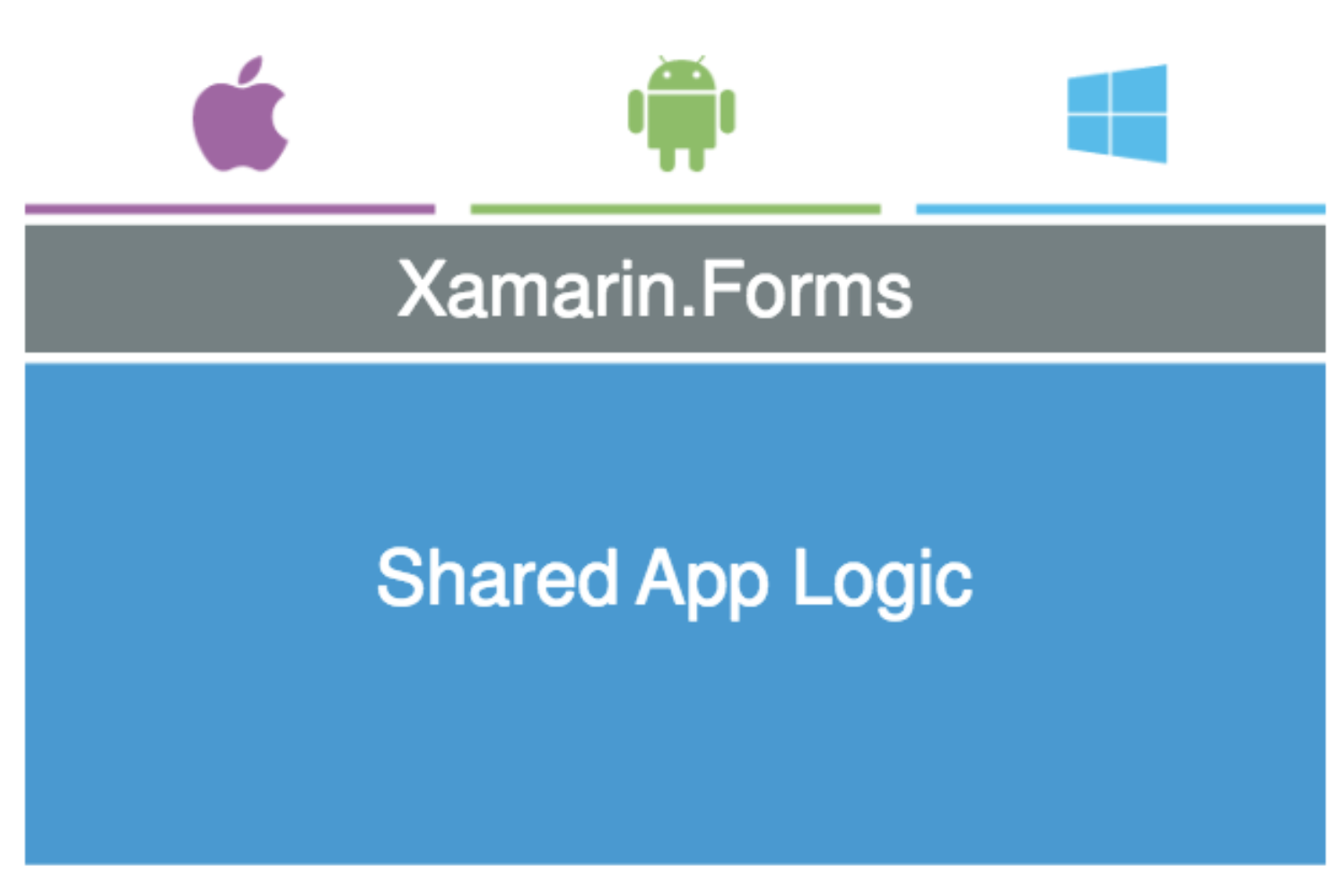
Xamarin.Forms client
Theory: write UI once, use everywhere
Notes:
** demo **

Slide 16
Xamarin.Forms client: challenges
Keep code maintainable: using MVVM (Prism)
Make UI look ‘decent’ on all platforms
Native screens
Native renderers
Notes:
** demo **

Slide 17
Demo Xamarin.Forms
Notes:
** demo **

Slide 18
Resources
Bot framework
Getting started: https://docs.botframework.com/en-us/csharp/builder/sdkreference/gettingstarted.html
Visual Studio Template: http://aka.ms/bf-bc-vstemplate
Emulator: https://emulator.botframework.com/
NuGet: Microsoft.Bot.Builder
LUIS: https://www.luis.ai
Installing Xamarin in VS 2017: http://motzcod.es/post/158155898027/setting-up-vs-2017-for-xamarin-dev

